Slide 1
What (artificial) intelligence to generate IETF standards (and patents)?
Zied Ben Houidi
05-07-2018
Z. B. Houidi “A knowledge-based systems approach to reason about networking” in ACM HotNets, Nov’16

Slide 2
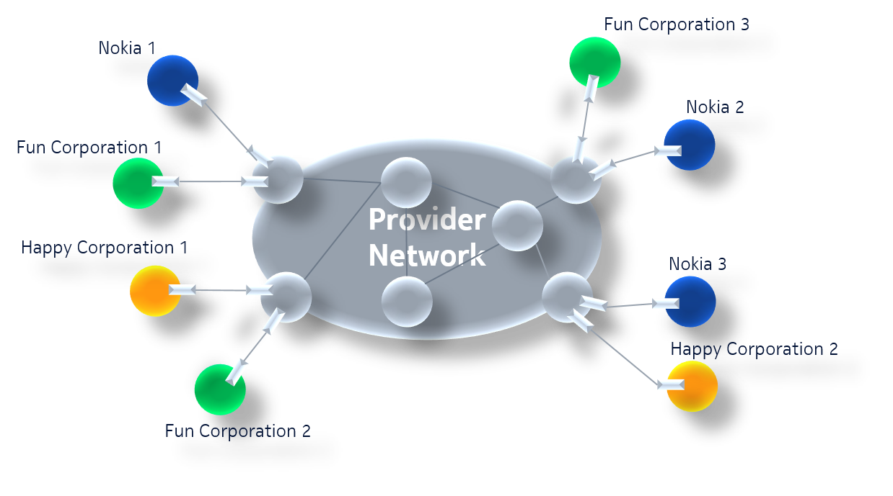
The corporate VPNs/Virtual network connectivity problem…
A technical problem, 15+ years of standardization efforts…
Technical, solved by humans:
  Need to master a lot of technologies (IP, MPLS, LDP, BGP, IP routing, label switching etc)
  Ability to see the big picture in networking
A plethora of:
  Solutions/Standards
  From 1998 (BGP MPLS VPNs RFC 2547)
  Till 2015 (Ethernet VPN RFC 7432)
Notes:
Some reviewers said on a previous position paper: if you are able to answer the question for VPNs, then you answered it for all inter-networking. The VPN case is a more complex case compared to the Internet case.

Slide 3
How does a « human solution » to this problem look like?
An IETF RFC…
A text document explaining the solution
  Help vendors implement new necessary functionalities in routers
  Help network operators configure and manage their networks
A set of guidelines along:
  How Sites/End Hosts should communicate
  What are router/switch capabilities/functionalities
  What routing/switching information routers need
  What headers are encapsulated/decapsulated
  What protocols/methods to distribute routing/switching information
  How this information is encoded in routing messages etc.
What intelligence to automatically generate this?

Slide 4










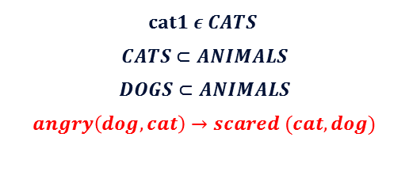



Imagine
The human ‘intelligent’ engine
Disclaimer: My current understanding…
Knowledge representation
Distinguish
Reasoning/inference
Name/Describe
Observable World
$$cat1 ε CATS$$
$$CATS⊂ANIMALS$$
$$DOGS⊂ANIMALS$$
$$angry\left(dog,cat\right)→scared (cat,dog)$$
Compare
Recall
Classify
Observe
Drive/Plan/goals
Full autonomy
$$something$$
$$cat$$
$$dog$$

Slide 5
Each of these pieces can be matched to a field in AI…
Disclaimer… Loose classification…
Automated reasoning
Machine Learning
Missing?
Knowledge representation and reasoning
Deep learning
Discriminative models
Reinforcement learning
Generative models?
Sensors
Knowledge representation
Distinguish
Drive/Plan
Imagine/Create
Compare
Autonomy
Name/Describe
Reasoning/Inference
Observe
Classify
Drive/Plan
Autonomy
Text, Images, sounds, smells …

Slide 6
Multiple complementary intelligence strategies… and not a single one…
The usual disclaimer…
The pilot: a reward/punishment based agent
  What to do and where to go…
Connectionism
  Learning invariant structure from noisy input
  Knowledge acquisition, interpretation and transfer
Computationalism/Symbolic reasoning
  « Blind » manipulation of symbols following rules can be powerful
  Language, Turing machines … and modern computers…
  The language of thoughts hypothesis…
  An interesting way of representing and manipulating knowledge…
Knowledge manipulation
Knowledge acquisition
Interpretation
Action
If curious, check the computationalism vs. Connectionsim debate…

Slide 7
Back to my problem… Let’s do it the symbolic/rule-based way
Using existing knowledge-based inference engines…
Knowledge representation
Problem formulation
Automatic generation of high level solutions:
How sites should behave
Capabilities of network elements
Needed information for network elements
Protocols to use
Existing Knowledge-based inference engine
Forward chaining
  Infer new facts
Backward chaining
  Prove statements and explain proofs
Execute code with statements
Facts base
daughter(IAlice,Bob)
Rules base
If father($father,$child) and female($child)
then daughter($child,$father)
Notes:
Only two possible outcomes:
- what knowledge is necessary to generate these solutions
- What do current inference engines lack

Slide 8
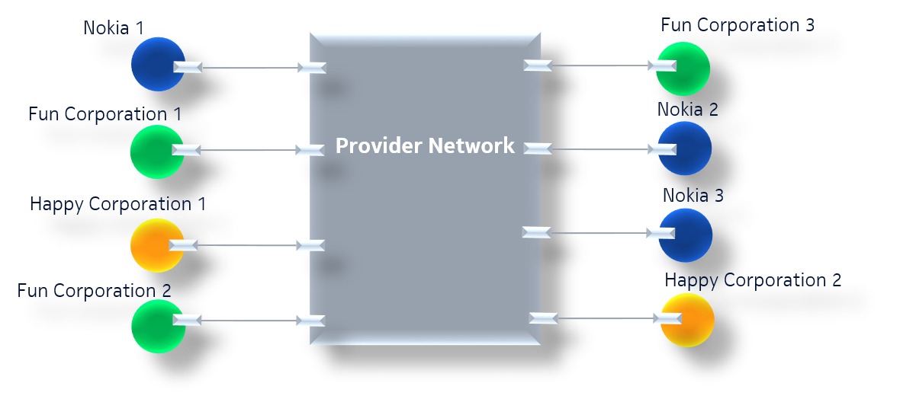
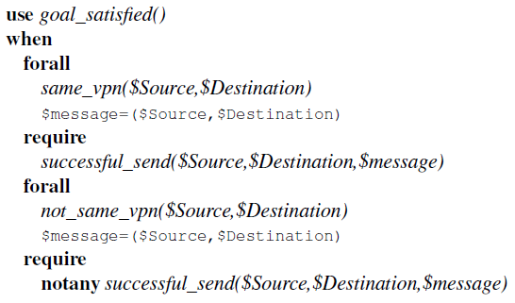
Problem formulation
Prove the connectivity goal

Slide 9
Break a high level goal into simpler and straightforward sub-goals
«The tree of thoughts»
successful_send($Source,$Destination,$message)
event_receive($Destination,$message,$headers)
check MACDest in $headers
Send Same Network
event_provider_exit($message,$I_destination,$headers)
Send Distant Network
$I_destination=Get_Interface($Destination)
event_send($Source,$Destination,$message,$headers_in)
$Source,$Destination)=Get_Hosts($message)
event_tunnel($message,$I_source,$I_destination,$headers)
connected($Source,$I_source)
event_provider_enter($message,$headers_in,$I_source)
capabilities.can_extract_IP_Dest_from_Header()
IP_Based_Decision
capabilities.per_interface_IP_routing()
information_IP_to_Interface_mapping()
BGP
MAC_Based_Decision
event_decide_exit($I_source,$headers_in,$I_decision)
check $I_decision==$I_destination
capabilities.can_extract_MAC_Dest_from_Header()
AC_Based_Decision
capabilities.per_interface_MAC_routing()
event_transform_header($headers_in,$headers,$I_decision)
information_MAC_to_Interface_mapping()
BGP
MPLS
Keep Header
MAC learning
capabilities.capability_network_tunnel()
Keep only IP header
IP-in-IP
GRE
Notes:
Statements are simple => less prone to misunderstandings.

Slide 10
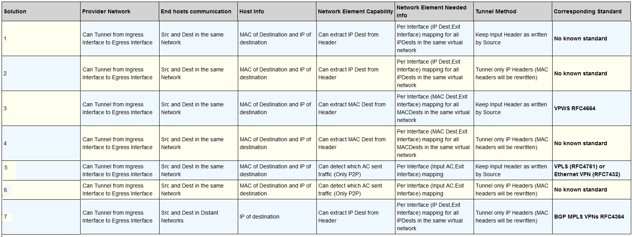
Proving the goal, returned output
Rediscovered all existing standards… and a new counter intuitive solution…
Patented
Notes:
Source and Destination L2, but network uses L3 information for routing => interesting, counter intuitive.
Counter intuitive, works but apparently useless

Slide 11




Let’s look at the interpretation of the symbols/predicates we used…
Send (source location, destination location, object)
Receive (location,object)
Modify (object)
Recognize (Object)
We transfered what we knew about how physical objects move in space to information/messages in computer networks
The importance of common sense reasoning for a variety of problems…

Slide 12
As a summary…
There is no single intelligence…
Common-sense reasoning is important
I tend sometimes to forget that:
  Computationalist intelligence is what allows us to emulate neural networks
  Abstract reasoning is our most « recent intelligent weapon »
  Neural networks might be « fundamentally » not fit to perform it

Slide 14
Emulating a mental process to automate the reasoning about our problem
1. « Inductive reasoning »
Reason on a concrete small intuitively representative toplogy
Assume the reasoning will be valid for larger topologies
Although topology is fixed, reasoning rules are generic
Assumptions:
Sites are end hosts
Only IP and MAC exist
« Big Switch» abstraction
Notes:
« All swans are white » while there are black swans in australia.
We assume the sun will rise tomorrow but we have no way to prove it.
The world is full of unknowns, we can conjecture stuff, sometimes we’re right, sometimes we’re wrong… Inductive reasoning is one of our main powerful means.

Slide 15
Emulating a mental process
2. Conceptual simulation
Our knowledge of how the protocol works is enough to use it to solve a problem
Emulate
  what would happen (events) and what would be needed (capabilities, routing information)
  …. when a message is sent to a destination
  …. When a protocol is used in the network

Slide 16
Emulating a mental process
3. Expert knowledge
Mixture of high level and low (packet) level rules
  High level rules:
    The MPLS protocol can be used to provide a tunneling service
    BGP can encode and distribute routing information
  Low level rules
    A message is successfully sent if the message is received by its destination
    How headers are transformed…

